Slide 1



Slide 2

Creating responsive
cross-platform UI
Mathieu Fillion
Practice Lead at nventive
and Uno Platform Developer

Slide 3
Creating responsive cross-platform UI
Cross-platform = tons of screens
Responsive/adaptive design is an important challenge

Slide 4
AdaptiveTriggers

Slide 5
What’s an AdaptiveTrigger?
Part of UWP and WinUI 3.0
Adapt to the window size via VisualStates
Works on iOS/Android/Web via Uno Platform

Slide 6
Let’s code!

Slide 7
Real-world example

Slide 8
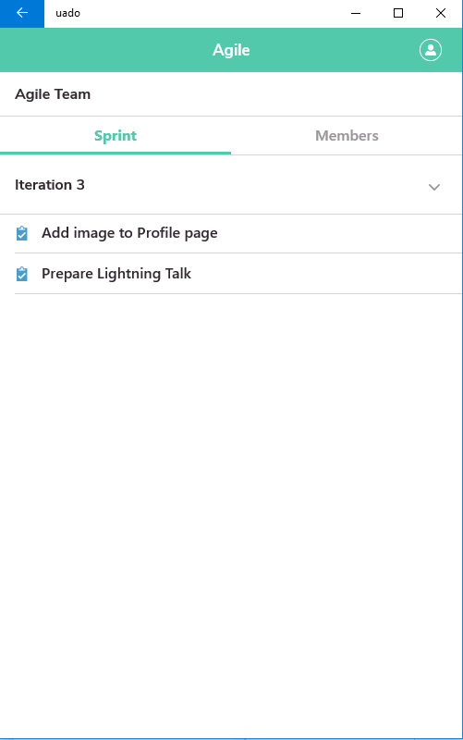
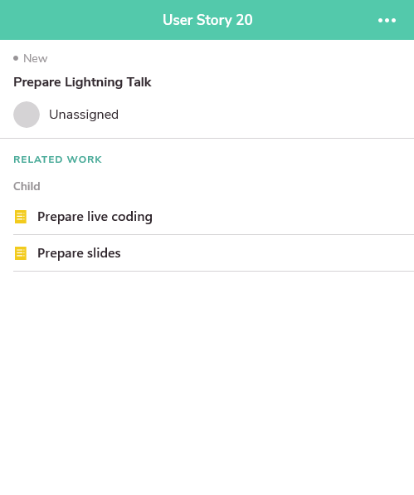
Universal Azure DevOps Organizer
Login with your azure devops account
Check your Sprints/Stories/Task
Open-sourced code
Good example to look at if you’re starting a new project
Shared C# and XAML code for iOS, Android and WebAssembly.

Slide 9
Let’s see!

Slide 10
Don’t forget mobile

Slide 11

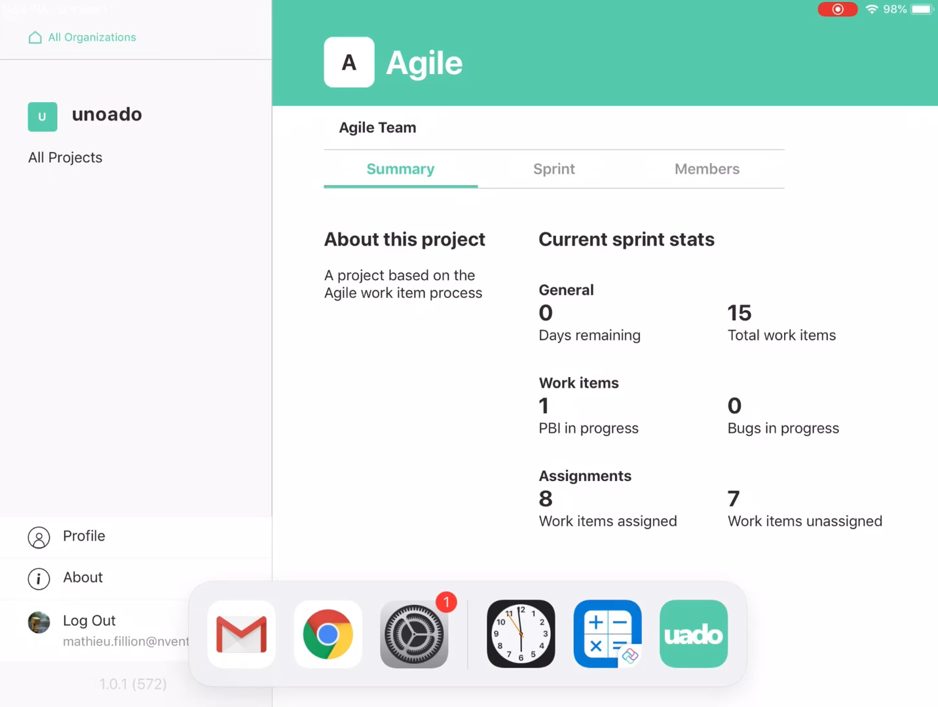
Resizing also a mobile reality

Slide 12
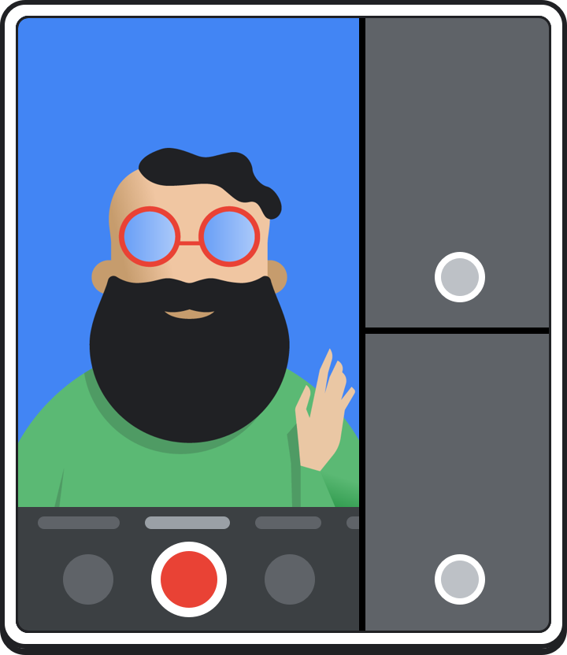
Resizing also a mobile reality
Android Foldable phones
Chrome OS running Android Apps
Android Foldable phones
Android multi-window

Slide 13
Amélie
Thank you

Slide 14
References
http://platform.uno
https://uado.platform.uno/
Images: https://developer.android.com/guide/topics/ui/foldables
Contact
https://twitter.com/mat_fillion
https://github.com/matfillion

